Slide 1
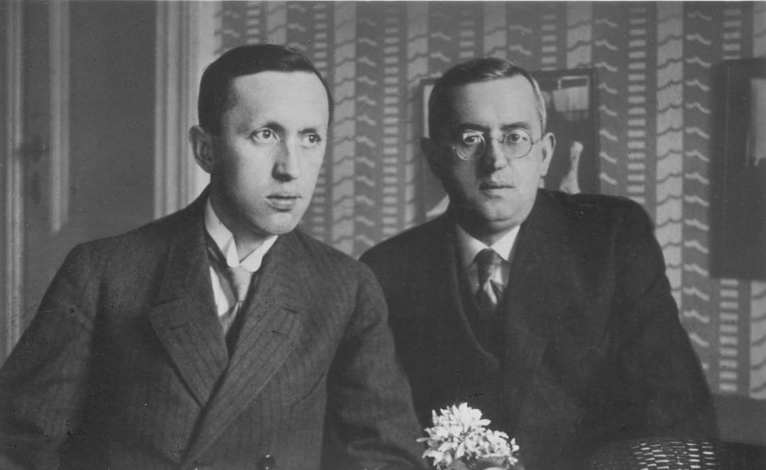
Daniele Procida
Messages from Prague

Slide 2
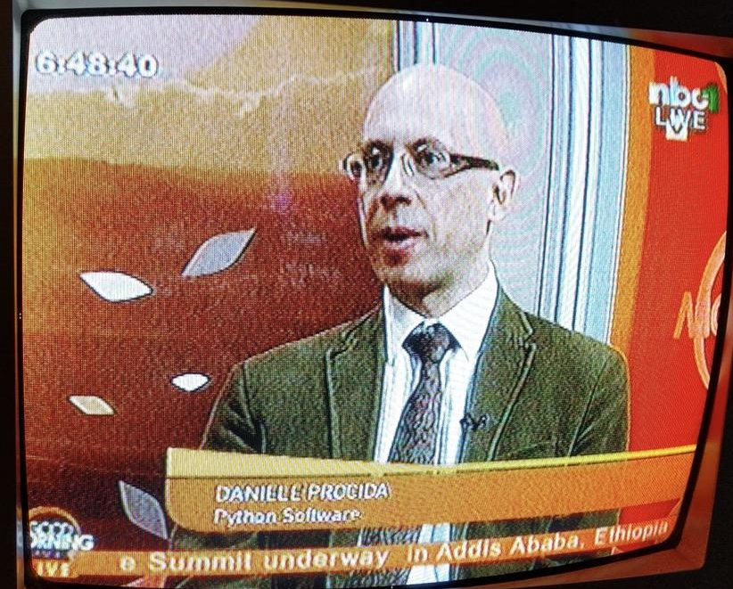
All about me
Daniele Procida Director of Engineering, Canonical
@EvilDMP@mastodon.online
Django Project core developer
open-source software contributor
Python community organiser
African Python movement enthusiast
software documentation disciplinarian
author of Diátaxis, diataxis.fr
Cardiff, UK • Leiden, NL

Slide 3

All about me
hiring, for all kinds of roles, especially Technical Authors
Daniele Procida Director of Engineering, Canonical
@EvilDMP@mastodon.online
Django Project core developer
open-source software contributor
Python community organiser
African Python movement enthusiast
software documentation disciplinarian
author of Diátaxis, diataxis.fr
Cardiff, UK • Leiden, NL

Slide 4

Zanzibar, Tanzania • 6-11 November • djangocon.africa

Slide 5

Messages from Prague
Daniele Procida
EuroPython 2023

Slide 6
1968
Prague Spring
1989
Velvet Revolution
1992
Velvet Divorce

Slide 7


Slide 8


Slide 9
Cities
Circuits
Software

Slide 10

Bohumil Kubišta, 1915

Slide 11
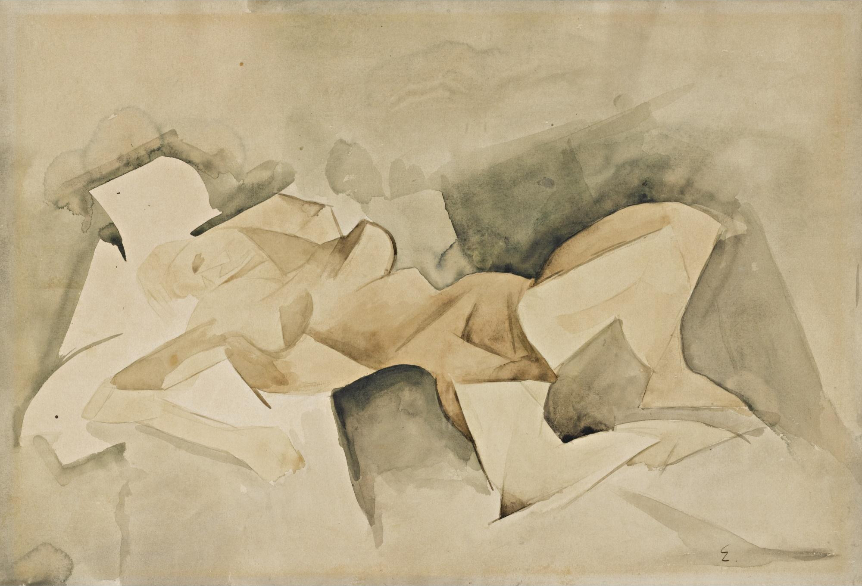
Emil Filla, ~1912

Slide 12

Josef Chochol, 1913-1914

Slide 13

Otakar Novotný, ~1921

Slide 14

Josef Gočár, 1911

Slide 15

Museum of Czech Cubism House of the Black Madonna

Slide 16
What is architecture?
form
space
material
purpose

Slide 17
Cubism addresses the question of representation.

Slide 18
Tutorials
How-to guides
Learning-oriented
Practical steps
Task-oriented
Serves study
Serves work
Understanding-oriented
Information-oriented
Explanation
Reference
Theoretical knowledge
Diátaxis - diataxis.fr

Slide 19
Architectural thinking and practice

Slide 20

Josef Čapek, 1920

Slide 21

Karel Čapek Rossum’s Universal Robots, 1920

Slide 22

Karel Čapek War with the newts, 1936

Slide 23
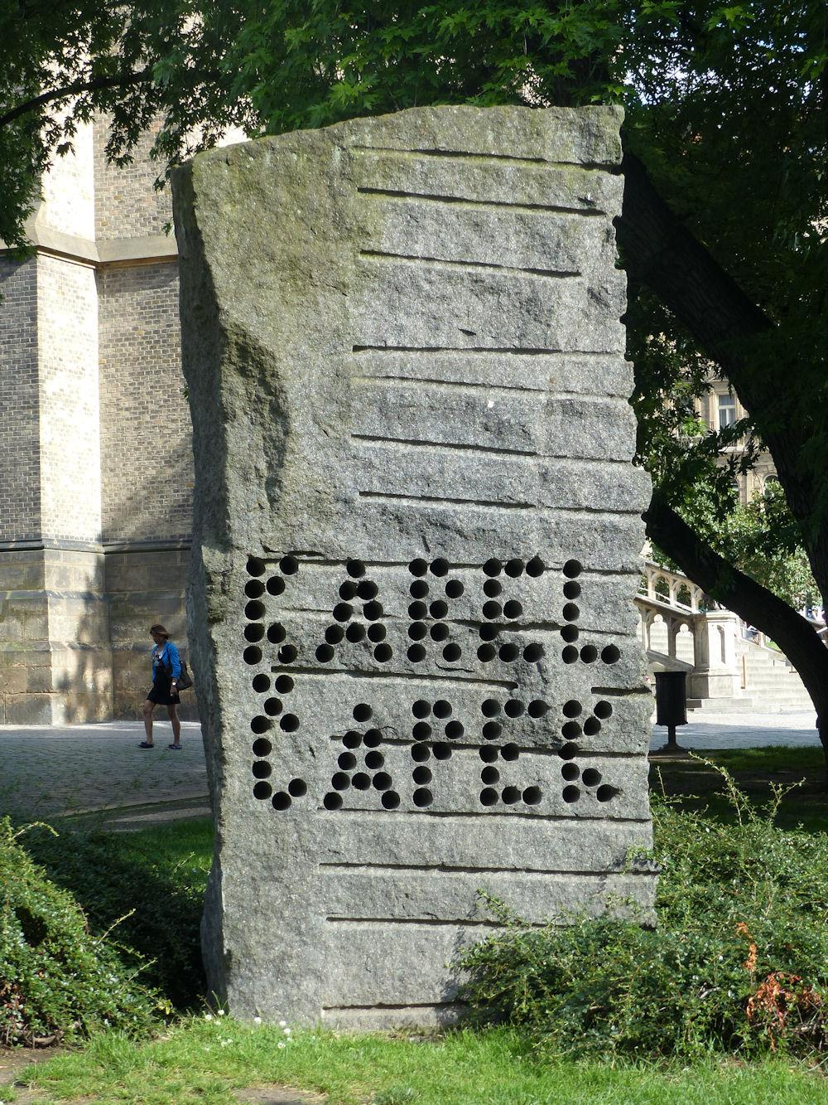
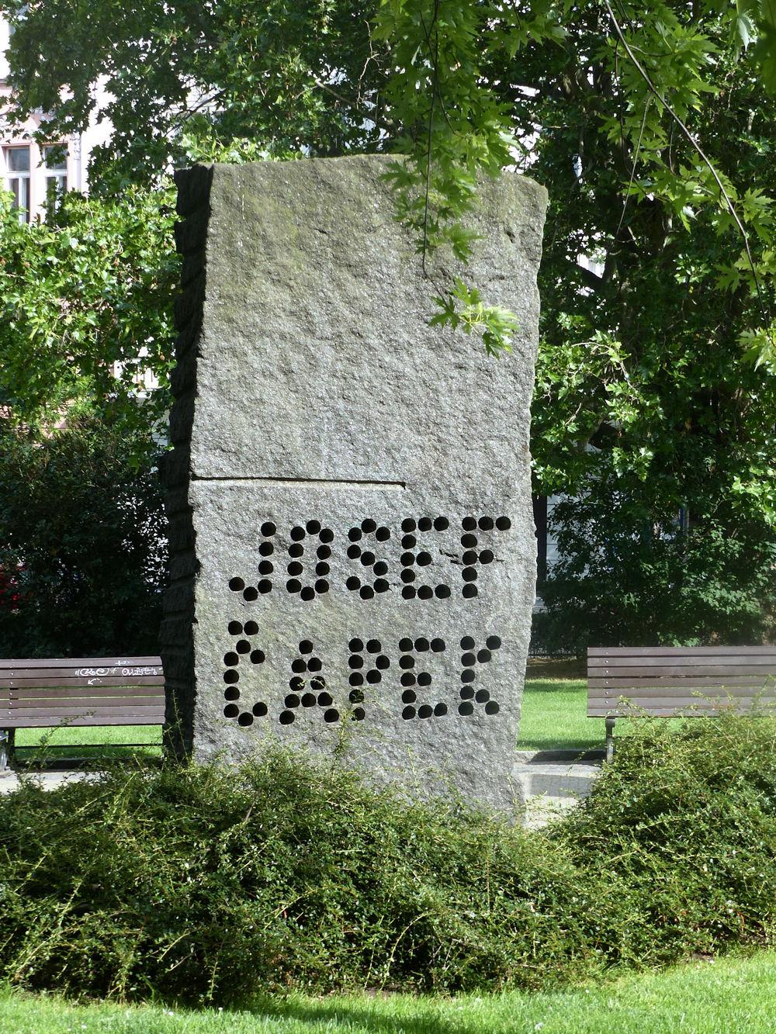

Slide 24
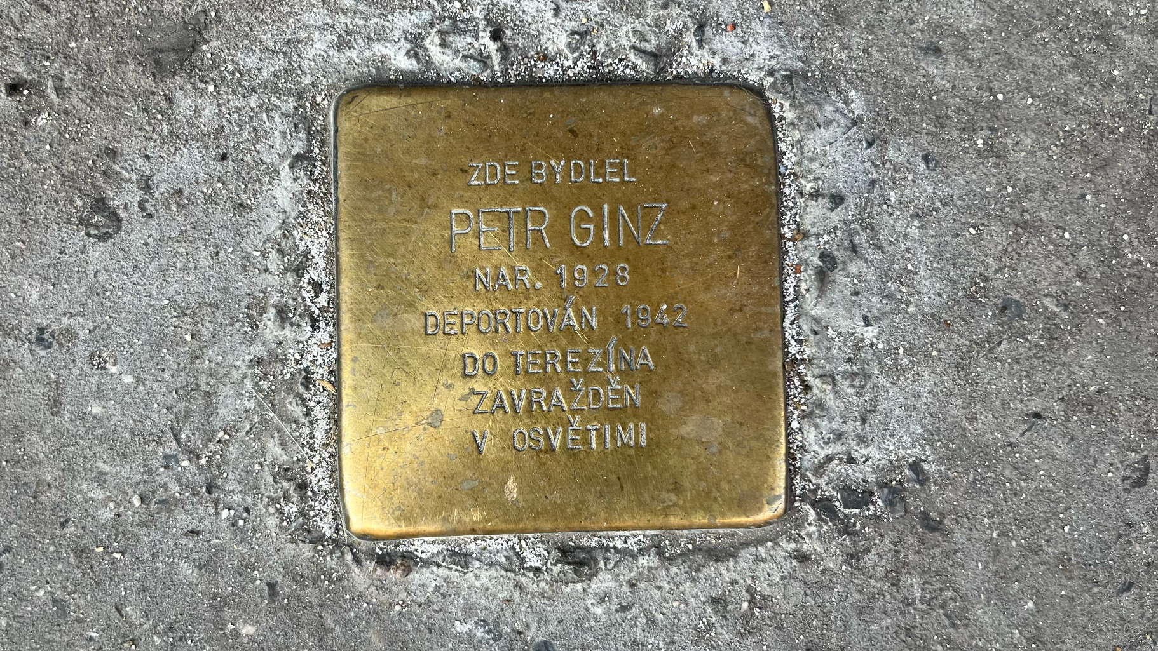

Slide 25
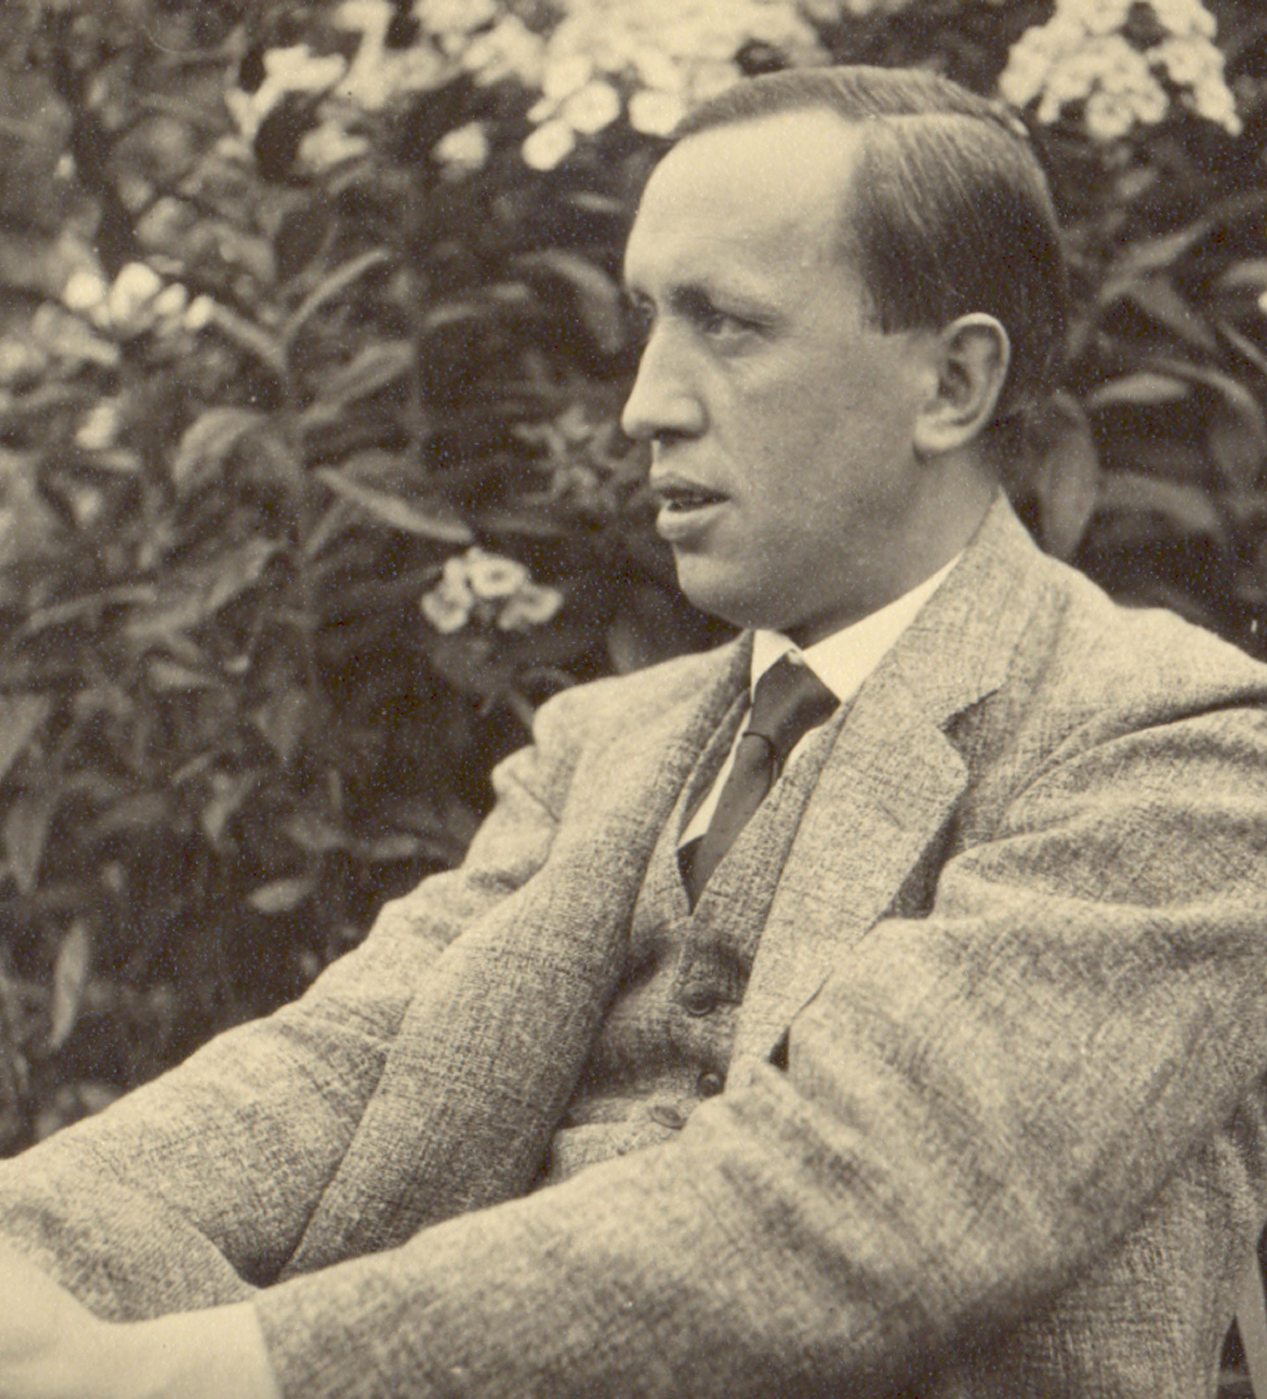
Karel Čapek
“Public enemy number 2”

Slide 26
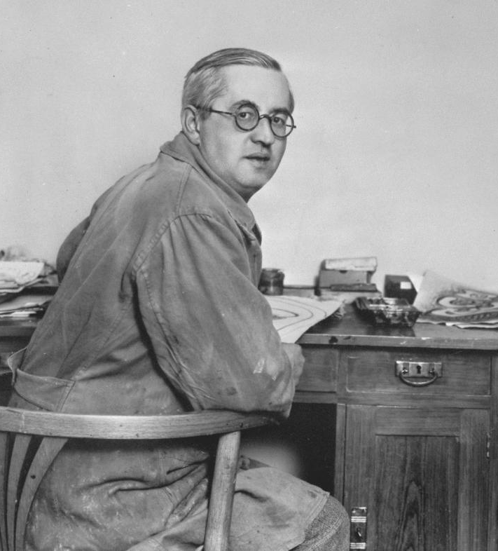
Josef Čapek
arrested: 1939, Prague
died: 1945, Bergen-Belsen

Slide 27
Messages
Received, understood, acted on

Slide 28
Thank you
Any questions?

Slide 29
Zanzibar, Tanzania
6-11 November
djangocon.africa
I’m hiring, for all kinds of roles, especially Technical Authors

